Slide 1
UNIT- 4
Reinforcement Learning

Slide 2
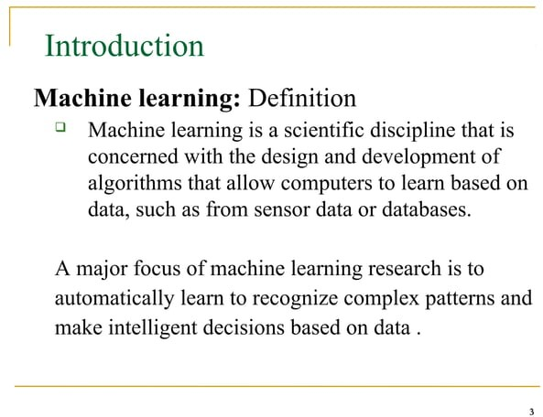

Slide 3
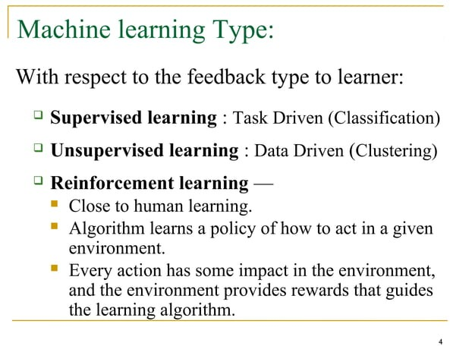

Slide 4
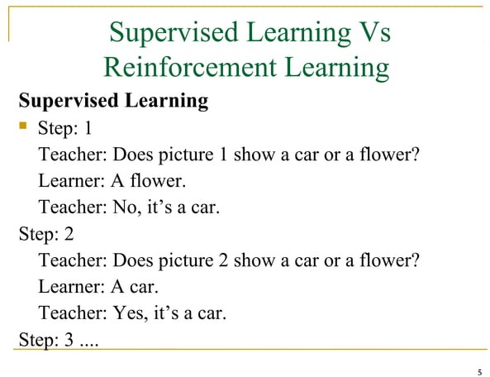

Slide 5
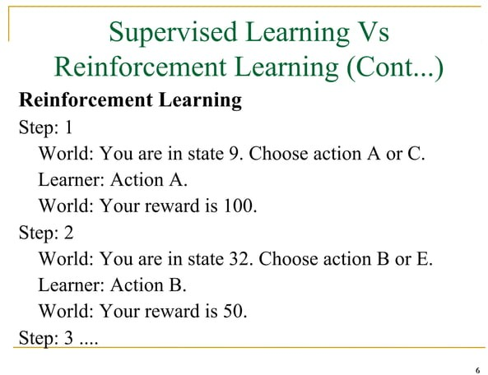

Slide 6
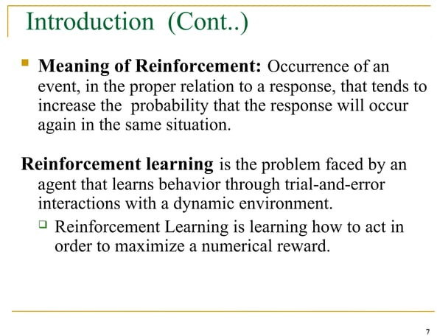

Slide 7
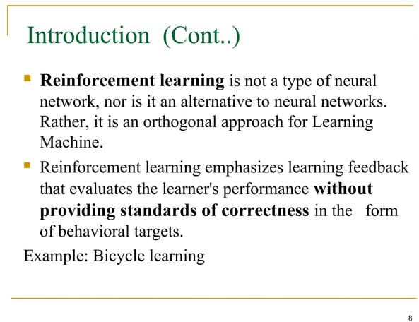

Slide 8
Reinforcement Learning
Reinforcement learning (RL) is a type of machine learning paradigm where an agent learns to make decisions by interacting with an environment.
It is about learning the optimal behavior in an environment to obtain maximum reward.
It is a machine learning paradigm that focuses on training intelligent agents to make sequences of decisions in order to maximize a cumulative reward signal.
It is inspired by behavioral psychology and is often used in scenarios where an agent interacts with an environment to learn a policy that helps it achieve a specific goal over time.
In RL, the data is accumulated from machine learning systems that use a trial-and-error method. Data is not part of the input that we would find in supervised or unsupervised machine learning.

Slide 9
Reinforcement learning uses algorithms that learn from outcomes and decide which action to take next.
After each action, the algorithm receives feedback that helps it determine whether the choice it made was correct, neutral or incorrect.
It is a good technique to use for automated systems that have to make a lot of small decisions without human guidance.
“Reinforcement learning is an autonomous, self-teaching system that essentially learns by trial and error. It performs actions with the aim of maximizing rewards, or in other words, it is learning by doing in order to achieve the best outcomes.”

Slide 10
Terms used in Reinforcement Learning
Agent(): An entity that can perceive/explore the environment and act upon it.
Environment(): A situation in which an agent is present or surrounded by. In RL, we assume the stochastic environment, which means it is random in nature.
Action(): Actions are the moves taken by an agent within the environment.
State(): State is a situation returned by the environment after each action taken by the agent.
Reward(): A feedback returned to the agent from the environment to evaluate the action of the agent.
Policy(): Policy is a strategy applied by the agent for the next action based on the current state.
Value(): It is expected long-term retuned with the discount factor and opposite to the short-term reward.
Q-value(): It is mostly similar to the value, but it takes one additional parameter as a current action (a).

Slide 11
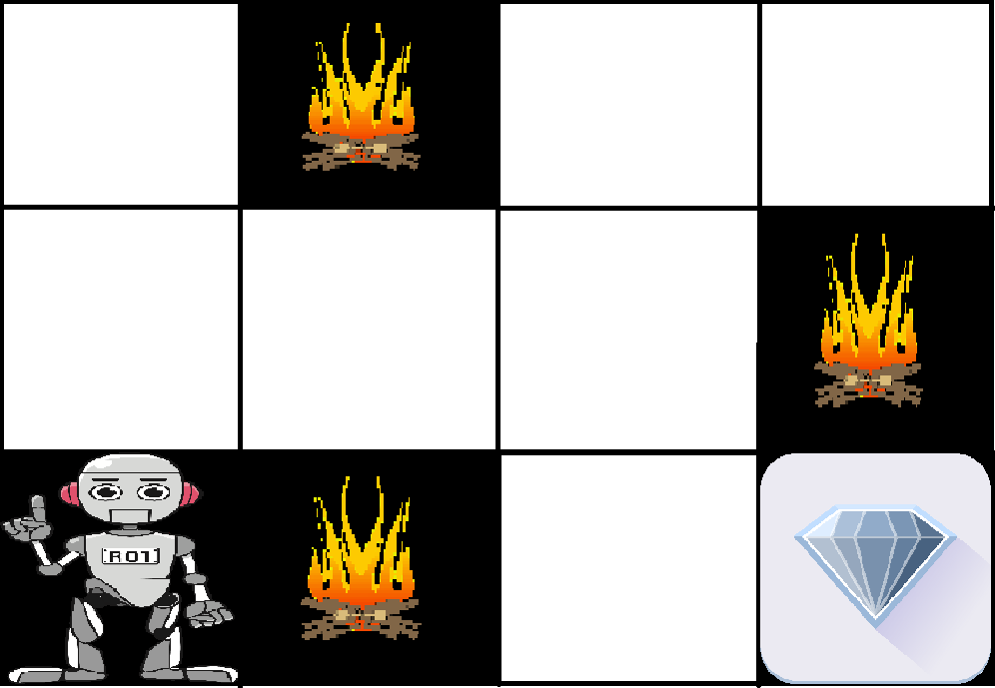
Example:
The problem is as follows: We have an agent and a reward, with many hurdles in between. The agent is supposed to find the best possible path to reach the reward. The following problem explains the problem more easily.

Slide 12
The image shows the robot, diamond, and fire.
The goal of the robot is to get the reward that is the diamond and avoid the hurdles that are fired.
The robot learns by trying all the possible paths and then choosing the path which gives him the reward with the least hurdles.
Each right step will give the robot a reward and each wrong step will subtract the reward of the robot.
The total reward will be calculated when it reaches the final reward that is the diamond.

Slide 13
Main points in Reinforcement learning:
Input: The input should be an initial state from which the model will start.
Output: There are many possible outputs as there are a variety of solutions to a particular problem.
Training: The training is based upon the input, The model will return a state and the user will decide to reward or punish the model based on its output.
The model keeps continues to learn.
The best solution is decided based on the maximum reward.

Slide 14
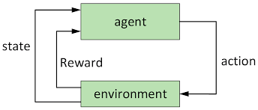

Slide 15
Key Features of Reinforcement Learning
In RL, the agent is not instructed about the environment and what actions need to be taken.
It is based on the hit and trial process.
The agent takes the next action and changes states according to the feedback of the previous action.
The agent may get a delayed reward.
The environment is stochastic, and the agent needs to explore it to reach to get the maximum positive rewards.

Slide 16
Approaches to implement Reinforcement Learning:
There are mainly three ways to implement reinforcement-learning in ML, which are:
Value-based
Policy-based Model-based

Slide 17
value-based approach: The value-based approach is about to find the optimal value function, which is the maximum value at a state under any policy. Therefore, the agent expects the long-term return at any state(s) under policy π.
Value-based reinforcement learning (RL) methods involve approximating the value function, which estimates the expected cumulative reward an agent can obtain from a given state or state-action pair under a certain policy. The value function helps the agent to make informed decisions by evaluating the desirability of different states or actions.

Slide 18
Policy-based: Policy-based approach is to find the optimal policy for the maximum future rewards without using the value function. In this approach, the agent tries to apply such a policy that the action performed in each step helps to maximize the future reward.
The policy-based approach has mainly two types of policy:
Deterministic: The same action is produced by the policy (π) at any state.
Stochastic: In this policy, probability determines the produced action.
Actor-Critic methods: Combine aspects of both value-based and policy-based methods, utilizing both a policy (actor) and a value function (critic) to make more efficient and stable updates.
model-based approach: In the model-based approach, a virtual model is created for the environment, and the agent explores that environment to learn it. There is no particular solution or algorithm for this approach because the model representation is different for each environment.

Slide 19
Elements of Reinforcement Learning
Reinforcement learning elements are as follows:
Policy
Reward function/Signal
Value function
Model of the environment

Slide 20
Policy:
A policy can be defined as a way how an agent behaves at a given time. It maps the perceived states of the environment to the actions taken on those states
Policy defines the learning agent behavior for given time period. It is a mapping from perceived states of the environment to actions to be taken when in those states.
A policy is the core element of the RL as it alone can define the behavior of the agent.
In some cases, it may be a simple function or a lookup table, whereas, for other cases, it may involve general computation as a search process. It could be deterministic or a stochastic policy:
For deterministic policy: a = π(s) For stochastic policy: π(a | s) = P[At =a | St = s]

Slide 21
Reward signal:
The goal of reinforcement learning is defined by the reward signal.
At each state, the environment sends an immediate signal to the learning agent, and this signal is known as a reward signal.
These rewards are given according to the good and bad actions taken by the agent.
The agent's main objective is to maximize the total number of rewards for good actions.
The reward signal can change the policy, such as if an action selected by the agent leads to low reward, then the policy may change to select other actions in the future.

Slide 22
value function:
The value function gives information about how good the situation and action are and how much reward an agent can expect.
A reward indicates the immediate signal for each good and bad action, whereas a value function specifies the good state and action for the future.
The value function depends on the reward as, without reward, there could be no value. The goal of estimating values is to achieve more rewards.

Slide 23
Model:
The last element of reinforcement learning is the model, which mimics the behavior of the environment.
With the help of the model, one can make inferences about how the environment will behave. Such as, if a state and an action are given, then a model can predict the next state and reward.
The model is used for planning, which means it provides a way to take a course of action by considering all future situations before actually experiencing those situations.
The approaches for solving the RL problems with the help of the model are termed as the model-based approach. Comparatively, an approach without using a model is called a model-free approach.

Slide 24
The Return in reinforcement learning
In reinforcement learning (RL), "The Return" refers to the cumulative reward that an agent receives when it interacts with an environment over a sequence of actions and states. It is a fundamental concept in RL and is often denoted as "G" or "R."
The Return is a way to measure the effectiveness of a policy, which is the strategy or set of actions that an RL agent follows to maximize its expected cumulative reward. The objective of an RL agent is typically to find the policy that maximizes its expected return over time.

Slide 25

The Return can be mathematically defined as the sum of rewards received by the agent from the start of an episode (or trajectory) until the end. An episode is a sequence of actions and states that begins with the initial state and ends when a certain termination condition is met. The Return is typically represented as:
Where:
Gt​ is the Return at time step t.
Rt​ is the reward received at time step t.
T is the time step at which the episode terminates.

Slide 26
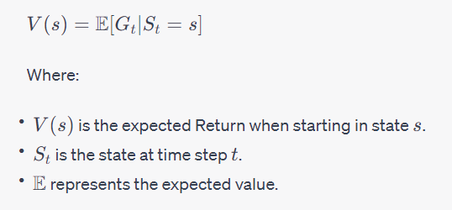
The goal of the RL agent is to find a policy that maximizes the expected value of the Return:
Alternatively, instead of working with the expected Return, the agent can also work with the expected sum of discounted rewards, called the "discounted return" or "discounted cumulative reward."

Slide 27

This involves multiplying each reward by a discount factor γ (where 0≤γ≤1) to give more importance to immediate rewards:
The choice of γ affects the agent's behavior and can be used to control the trade-off between immediate rewards and long-term rewards.

Slide 28
Discount Factor In Reinforcement Learning
The discount factor, commonly denoted as γ (gamma), is a parameter that influences how much weight is given to future rewards in the decision-making process of an RL agent.
It's a critical component used to calculate the discounted future rewards or returns in RL algorithms.
The discount factor γ determines the trade-off between immediate rewards and future rewards.
A higher γ places more emphasis on obtaining rewards in the future, making the agent more forward-looking and potentially more patient in its decision-making.
Conversely, a lower γ makes the agent focus more on immediate rewards, making it more myopic in its decisions.
A discount factor close to 1 implies that the agent values future rewards highly, potentially sacrificing short-term gains for larger long-term rewards.
A discount factor close to 0 implies that the agent values immediate rewards more and tends to make decisions that maximize short-term gains.

Slide 29
Consider a simple scenario where an RL agent interacts with an environment over three time steps (t=0,1,2). The rewards obtained at each time step are R_t+1​=10,R_t+2​=5,R_t+3​=8, and use a discount factor of γ=0.9.
calculate the cumulative reward Gt​ at time step t=0.
G0​=R1​+γR2​+γ²R3​

Slide 30
R_t+1​=10
R_t+2​=5
R_t+3​=8
And the discount factor:
γ = 0.9
G_0 = R_1 + γ * R_2 + γ^2 * R_3
G_0 = 10 + 0.9 * 5 + 0.9^2 * 8
G_0 = 10 + 4.5 + 6.48
G_0 = 20.98

Slide 31
Deterministic Policies:
In a deterministic policy, the same control is always output for the same input state.
Usually the phi symbol denotes a policy function, which takes as input a state from the state space and always output the same control from the control space.
In general, the goal of RL is to learn the optimal controls for all possible states so that sum of all agent rewards is maximized.
Sometimes, a deterministic policy doesn't cut it for designers or engineers either due to competition among agents, partially observed system state, or other sources of noise that warrant stochastic policies.
In such challenging circumstances, a stochastic policy is more appropriate.

Slide 32
Mathematically, a deterministic policy can be represented as:
π(s) = a
Where:
π is the policy.
s is the current state of the environment.
a is the action to be taken in state s.

Slide 33
Key characteristics and considerations related to deterministic policies in RL:
Deterministic Mapping: Unlike stochastic policies that assign probabilities to actions in each state, deterministic policies directly specify the action to take. This means that for a given state, the agent always chooses the same action when following a deterministic policy.
Exploitation: Deterministic policies are well-suited for exploitation, where the agent selects the action it believes will yield the highest expected reward based on its current knowledge.
Deterministic Environments: Deterministic policies are often employed in environments where actions have predictable outcomes. In such environments, the best action can be consistently determined for each state.

Slide 34
4. Continuous Action Spaces: Deterministic policies are commonly used in RL problems with continuous action spaces, where specifying a single action is more practical than defining a probability distribution over a continuous range of actions.
5. Deterministic Policy Gradient: Some RL algorithms, like Deterministic Policy Gradient (DPG) or Deep Deterministic Policy Gradient (DDPG), specifically target deterministic policies. These algorithms aim to learn deterministic policies for continuous action spaces, often using neural networks.

Slide 35
6. Exploration Challenges: A drawback of deterministic policies is that they may struggle with exploration in uncertain environments. Since the same action is chosen for the same state, they do not naturally account for variability or risk. This can limit the agent's ability to discover better actions.
7. Local Optima: Deterministic policies can get stuck in local optima, especially in high-dimensional or complex environments. In contrast, stochastic policies provide more flexibility and randomness to escape local optima.
8. Policy Optimization: Methods for optimizing deterministic policies involve gradient-based techniques that seek to maximize the expected cumulative reward by adjusting the policy parameters. This typically requires differentiating through the policy to compute gradients.
9. Continuous Control: Deterministic policies are particularly useful in RL tasks involving continuous control, such as robotic control or autonomous driving, where precise and deterministic actions are often required.

Slide 36
Program for deterministic policies
import numpy as np
# Define the deterministic policy
def deterministic_policy(state):
if state == "S1":
return "A1"
elif state == "S2":
return "A2"
elif state == "S3":
return "A1"
else:
return "Invalid state"

Slide 37
# Define a function to simulate the environment
def simulate_environment(state, action):
# Define the transition dynamics (state -> action -> next_state)
transitions = {
"S1": {"A1": "S2", "A2": "S3"},
"S2": {"A1": "S1", "A2": "S3"},
"S3": {"A1": "S1", "A2": "S2"}
} # Define the reward function (state -> action -> next_state -> reward)
rewards = {
"S1": {"A1": {"S2": 10}, "A2": {"S3": 0}},
"S2": {"A1": {"S1": 0}, "A2": {"S3": 5}},
"S3": {"A1": {"S1": -1}, "A2": {"S2": 0}}
}
# Simulate the environment
next_state = transitions[state][action]
reward = rewards[state][action][next_state]
return next_state, reward
# Define the starting state
current_state = "S1"

Slide 38
# Run the deterministic policy
c_reward=0
for _ in range(0,10):
action = deterministic_policy(current_state)
print(f"Current State: {current_state}, Action: {action}")
next_state, reward = simulate_environment(current_state, action)
print(f"Next State: {next_state}, Reward: {reward}\n")
c_reward=c_reward+reward
current_state = next_state
print(“Cumulative Reward: ”, c_reward)

Slide 39
Stochastic Policies:
On the other hand, a stochastic policy is only a little bit more complicated.
A stochastic policy says that for any given state, each control is selected with some possibly non-zero probability.
One can think that for stochastic policies the agent conditions on the encountered state and selects controls according to a probability distribution. Because a stochastic policy is a distribution it must obey some rules.
Since we are dealing with the realm of finite spaces in this article the distribution is a discrete probability mass function.
The first rule is a sum rule, which says that for each possible state, the sum over all possible controls, the stochastic policy must sum to 1. These are the main differences between deterministic and stochastic policies.

Slide 40
Stochastic policies are a type of policy in reinforcement learning (RL) where, for a given state, the policy prescribes a probability distribution over the available actions. In other words, instead of selecting a single, deterministic action for each state, stochastic policies assign probabilities to different actions, allowing the agent to make decisions that incorporate randomness. Mathematically, a stochastic policy can be represented as:
π(a|s)
Where:
π is the policy.
a is an action.
s is the current state of the environment.
π(a|s) represents the probability of taking action a in state s.

Slide 41
key characteristics and considerations related to stochastic policies in RL:
Exploration: Stochastic policies naturally facilitate exploration because they allow the agent to choose from a range of actions with associated probabilities. This randomness helps the agent discover new actions and learn about the environment.
Uncertainty Handling: Stochastic policies are well-suited for environments with uncertainty or noise, where the outcomes of actions may vary. They allow the agent to account for this uncertainty by assigning different probabilities to different actions.
Balancing Exploration and Exploitation: Stochastic policies offer a balance between exploration and exploitation. The agent can explore by occasionally selecting actions with lower probabilities, while also exploiting actions with higher probabilities based on its current knowledge.

Slide 42
4. Continuous and Discrete Action Spaces: Stochastic policies can be used in RL problems with both continuous and discrete action spaces. In continuous action spaces, the policy typically defines a probability distribution over the entire action space.
5. Policy Gradients: Many RL algorithms that work with stochastic policies use policy gradient methods. These methods update the policy parameters in the direction that maximizes the expected cumulative reward. The gradients are typically computed using the probability distribution defined by the policy.
6. Sample-Based Execution: To execute actions according to a stochastic policy, the agent samples from the action distribution specified by the policy. This sampling process introduces randomness into the agent's actions.

Slide 43
7. Policy Improvement: Stochastic policies can be iteratively improved by adjusting the parameters of the policy to maximize expected rewards. Methods like REINFORCE and Proximal Policy Optimization (PPO) are commonly used for this purpose.
8. Risk-Awareness: In certain scenarios, stochastic policies can be used to express risk preferences. By assigning higher probabilities to actions with lower risk, the agent can make decisions that balance reward maximization with risk avoidance.
9. Policy Entropy: Stochastic policies have an associated entropy, which quantifies the amount of uncertainty or randomness in the policy's actions. Some algorithms use entropy regularization to encourage more exploration or to balance exploration and exploitation.

Slide 44
Stochastic policy
import numpy as np
# Define a stochastic policy
def stochastic_policy(state):
if state == "S1":
action_probs = {"A1": 0.6, "A2": 0.4}
elif state == "S2":
action_probs = {"A1": 0.3, "A2": 0.7}
elif state == "S3":
action_probs = {"A1": 0.8, "A2": 0.2}
else:
raise ValueError("Invalid state")
# Sample an action based on the action probabilities
action = np.random.choice(list(action_probs.keys()), p=list(action_probs.values()))
return action

Slide 45
def simulate_environment(state, action):
# Define the transition dynamics (state -> action -> next_state)
transitions = {
"S1": {"A1": "S2", "A2": "S3"},
"S2": {"A1": "S1", "A2": "S3"},
"S3": {"A1": "S1", "A2": "S2"}
}
# Define the reward function (state -> action -> next_state -> reward)
rewards = {
"S1": {"A1": {"S2": 10}, "A2": {"S3": 0}},
"S2": {"A1": {"S1": 0}, "A2": {"S3": 5}},
"S3": {"A1": {"S1": -1}, "A2": {"S2": 0}}
}
# Simulate the environment
next_state = transitions[state][action]
reward = rewards[state][action][next_state]
return next_state, reward
# Define the starting state
current_state = "S1"

Slide 46
# Run the stochastic policy for a few time steps
c_reward=0
for _ in range(5):
action = stochastic_policy(current_state)
print(f"Current State: {current_state}, Action: {action}")
next_state, reward = simulate_environment(current_state, action)
print(f"Next State: {next_state}, Reward: {reward}\n")
c_reward+=reward
current_state = next_state
print(“Cumulative Reward: “, c_reward)

Slide 47
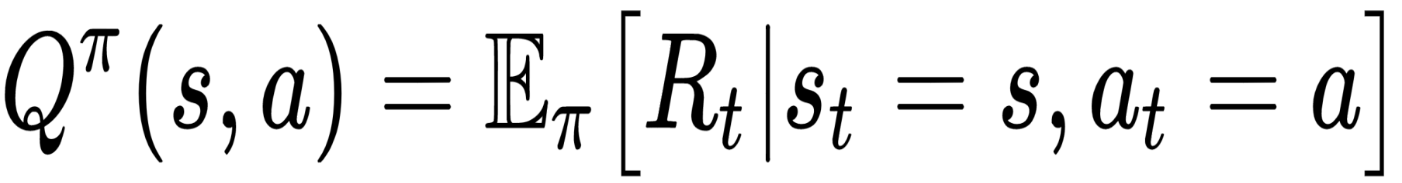
State-action value function definition
A state-action value function is also called the Q function. It specifies how good it is for an agent to perform a particular action in a state with a policy π. The Q function is denoted by Q(s). It denotes the value of taking an action in a state following a policy π.
We can define Q function as follows:

Slide 48
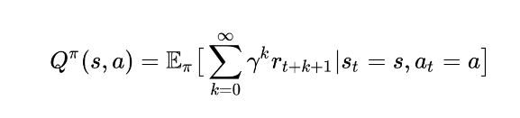
This specifies the expected return starting from state s with the action a according to policy π. We can substitute the value of R_{t} in the Q function from (2) as follows:

Slide 49
State-action value function example:
Suppose you have a robot that needs to navigate a grid-world environment. In this grid world, the robot can be in different states, and it can take various actions. The goal of the robot is to maximize its cumulative reward over time.
Here's an example of a state-action value function Q(s, a) for a specific state and action:
Let's say the robot is currently in a state 'S', which corresponds to a particular cell in the grid-world, and it has the option to take one of three possible actions: move up, move down, or move right.
State 'S': Robot's current location in the grid-world.
Actions:
Action 'A1': Move up
Action 'A2': Move down
Action 'A3': Move right

Slide 50
The state-action value function Q(S, A) might look like this:
Q(S, A1) = 5: This means that if the robot is in state 'S' and it chooses to move up ('A1'), it expects to receive a cumulative reward of 5 in the long run.
Q(S, A2) = 2: If the robot decides to move down ('A2') in state 'S', it expects to receive a cumulative reward of 2 over time.
Q(S, A3) = 4: Choosing to move right ('A3') in state 'S' is expected to result in a cumulative reward of 4.
The values in the state-action value function represent the expected cumulative rewards associated with taking each action in the given state. The robot would use this information to make decisions and select the action that maximizes the expected cumulative reward in its current state.

Slide 51
Bellman Equation
It describes the relationship between the value of a state or state-action pair and the expected cumulative rewards that can be obtained from that state or state-action pair.
There are two main forms of the Bellman equation: the Bellman Expectation Equation for state values and the Bellman Expectation Equation for action values.

Slide 52
Bellman Equation
According to the Bellman Equation, long-term- reward in a given action is equal to the reward from the current action combined with the expected reward from the future actions taken at the following time. Let’s try to understand first.

Slide 53
How does Reinforcement Learning Work?
To understand the working process of the RL, we need to consider two main things:
Environment: It can be anything such as a room, maze, football ground, etc.
Agent: An intelligent agent such as AI robot.
Let's take an example of a maze environment that the agent needs to explore. Consider the below image:

Slide 54
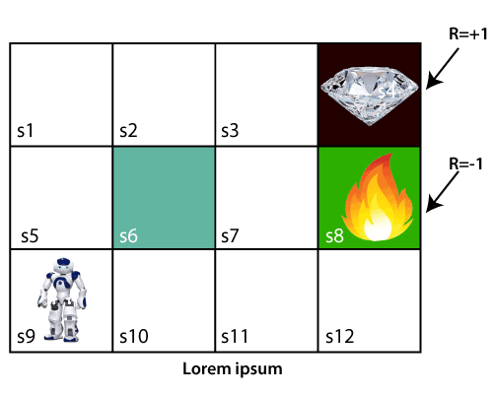

Slide 55
In the above image, the agent is at the very first block of the maze. The maze is consisting of an S₆ block, which is a wall, S₈ a fire pit, and S₄ a diamond block.
The agent cannot cross the S₆ block, as it is a solid wall. If the agent reaches the S₄ block, then get the +1 reward; if it reaches the fire pit, then gets -1 reward point. It can take four actions: move up, move down, move left, and move right.
The agent can take any path to reach to the final point, but he needs to make it in possible fewer steps. Suppose the agent considers the path S9-S5-S1-S2-S3, so he will get the +1-reward point.

Slide 56
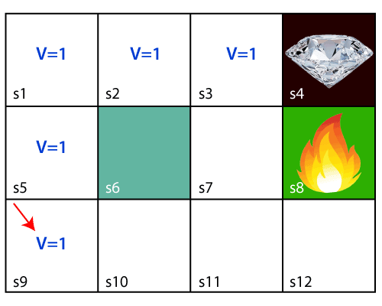
The agent will try to remember the preceding steps that it has taken to reach the final step. To memorize the steps, it assigns 1 value to each previous step. Consider the below step:

Slide 57
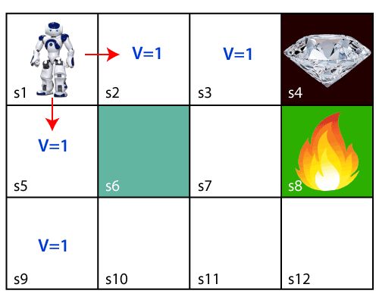
Now, the agent has successfully stored the previous steps assigning the 1 value to each previous block. But what will the agent do if he starts moving from the block, which has 1 value block on both sides? Consider the below diagram:
It will be a difficult condition for the agent whether he should go up or down as each block has the same value. So, the above approach is not suitable for the agent to reach the destination. Hence to solve the problem, we will use the Bellman equation, which is the main concept behind reinforcement learning.

Slide 58
The Bellman equation was introduced by the Mathematician Richard Ernest Bellman in the year 1953, and hence it is called as a Bellman equation. It is associated with dynamic programming and used to calculate the values of a decision problem at a certain point by including the values of previous states.
It is a way of calculating the value functions in dynamic programming or environment that leads to modern reinforcement learning.
The key-elements used in Bellman equations are:
Action performed by the agent is referred to as "a"
State occurred by performing the action is "s."
The reward/feedback obtained for each good and bad action is "R."
A discount factor is Gamma "γ."

Slide 59
The Bellman equation can be written as:
V(s) = max [R(s,a) + γV(s`)]
Where,
V(s)= value calculated at a particular point.
R(s,a) = Reward at a particular state s by performing an action.
γ = Discount factor
V(s`) = The value at the previous state.
In the above equation, we are taking the max of the complete values because the agent tries to find the optimal solution always.

Slide 60
For s3 block:
V(s3) = max [R(s,a) + γV(s`)], here V(s')= 0 because there is no further state to move.
V(s3)= max[R(s,a)]=> V(s3)= max[1]=> V(s3)= 1.
R(s,a)=1 (Reward of +1, which moves towards right), γ=0.9

Slide 61
For s2 block:
V(s2) = max [R(s,a) + γV(s`)], here γ= 0.9(lets), V(s')= 1 (Previous State Value), and R(s, a)= 0, because there is no reward at this state.
V(s2)= max[0.9(1)]=> V(s2)= max[0.9]=> V(s2) =0.9
For s1 block:
V(s1) = max [R(s,a) + γV(s`)], here γ= 0.9(lets), V(s')= 0.9, and R(s, a)= 0, because there is no reward at this state also.
V(s1)= max[0.9(0.9)]=> V(s1)= max[0.81]=> V(s1) =0.81
For s5 block:
V(s5) = max [R(s,a) + γV(s`)], here γ= 0.9(lets), V(s')= 0.81, and R(s, a)= 0, because there is no reward at this state also.
V(s5)= max[0.9(0.81)]=> V(s5)= max[0.73]=> V(s5) =0.73
For s9 block:
V(s9) = max [R(s,a) + γV(s`)], here γ= 0.9(lets), V(s')= 0.73, and R(s, a)= 0, because there is no reward at this state also.
V(s9)= max[0.9(0.73)]=> V(s9)= max[0.657]=> V(s4) =0.66

Slide 62
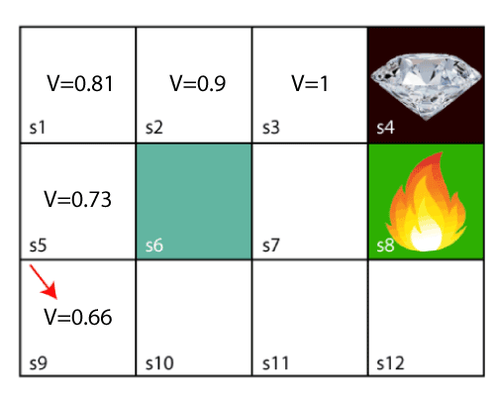
Now, we will move further to the 6th block, and here agent may change the route because it always tries to find the optimal path. So now, let's consider from the block next to the fire pit.

Slide 63
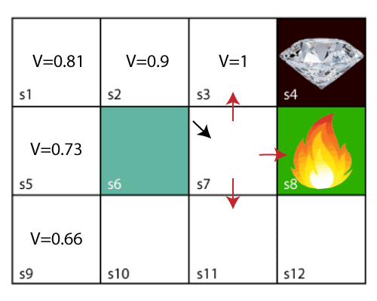
Now, the agent has three options to move; if he moves to the blue box, then he will feel a bump if he moves to the fire pit, then he will get the -1 reward. But here we are taking only positive rewards, so for this, he will move to upwards only. The complete block values will be calculated using this formula. Consider the below image:

Slide 64
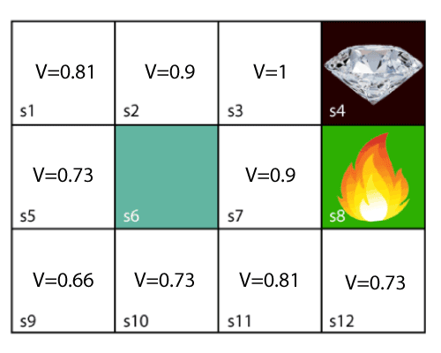

Slide 65
Thank you!

